Slide 1

Project CrayStation
Presentation by Keith Rickard
12 December 2024

Slide 2
What is CrayStation?
Remote observatories are expensive to set-up and run.
CrayStation is a remote micro-observatory with the following requirements:
Use of a smart telescope to easily point to, and image, night sky objects
Power independent
Easy to operate and download data files remotely
Simple and minimal interaction by the host
Can be used anywhere in the world with access to a WiFi connection to the internet
£1,000 budget
Minimal running costs
Available for use by all CMHASD members
There seems to be no example of this on the Internet – this could be a Crayford first!
This concept could be used for all suitable smart telescopes.

Slide 3
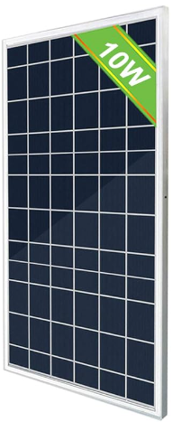
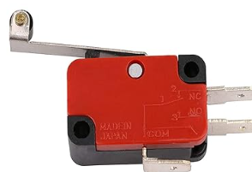
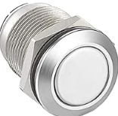
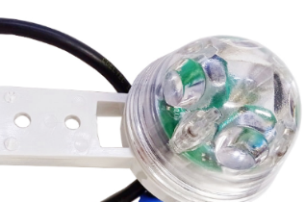
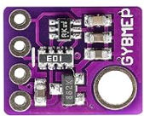
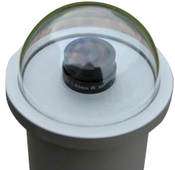
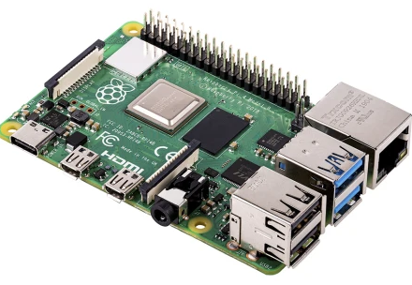
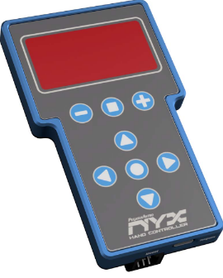
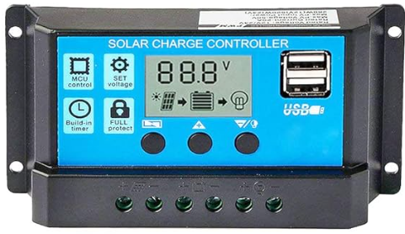
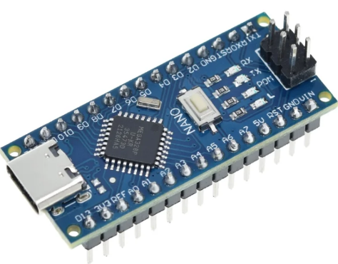
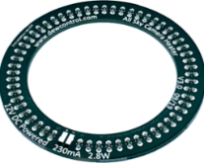
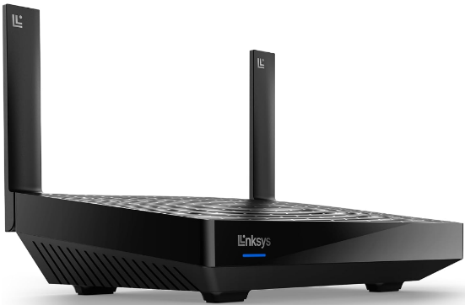
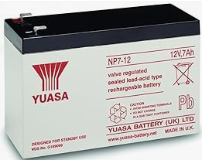
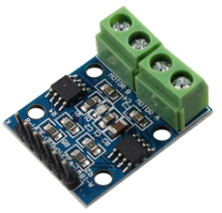
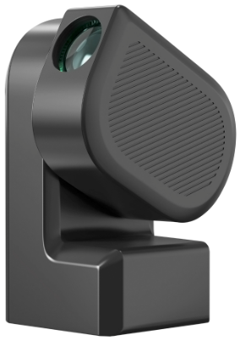
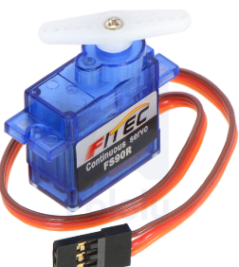
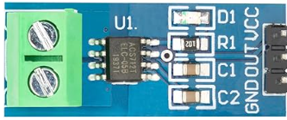
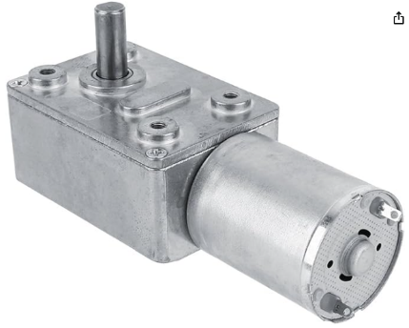
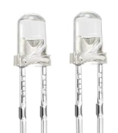
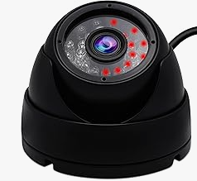
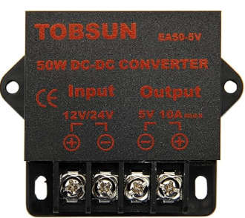
CrayStation Overview
Rain detector
SR
Raspberry Pi 4
Enclosure lid sensors
Lid opening
manual button
All-sky camera
Solar panel
Environment sensor
Hand controller
Webcam heater
Arduino Nano
Regulator charger
Local router
12V Battery
Power controllers
Ammeter
Servo
Enclosure webcam
Enclosure LEDS
Enclosure
motor
12V to 5V converter
ZWO Seestar S50
12V 5V Signal USB WiFi

Slide 4
Components – ZWO Seestar S50
Specifications:
F5 50mm aperture folded refractor
Triplet achromatic optics
Sony IMX264 3.45um CMOS imaging sensor (1920 x 1080 pixels
Auto go-to and tracking, using plate solving for accurate pointing
Auto focussing
6 hour battery life
Good for imaging moon, deep sky objects, comet, Jupiter’s moons
64GB storage
Built-in WiFi (and Bluetooth)
Can be controlled by Android and IOS apps.
Two year warranty
(Has solar filter for solar imaging)

Slide 5
Components – Raspberry Pi 4 Model B (RPi)
Main computer. Responsible for:
Connecting to the Internet for remote user control
Control the telescope and observatory
Handle files and send them to the user
Control user login
Run various apps
Connects to Arduino, webcam and all-sky cam
Provide a Graphics User Interface experience for users
Relevant specifications:
1.5 GHz Quad-Core CPU
4GB ram
2x USB3.0 and 2 USB2.0 ports
WiFi (2.4 and 5.0 GHz)
MIPI CSI camera port
Power: 5V, 600mA – 3000mA

Slide 6
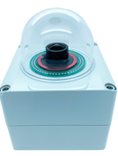
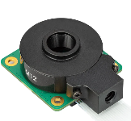
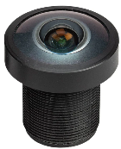
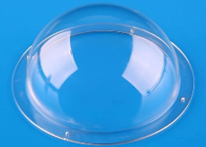
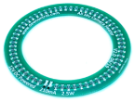
Components – All-sky cam
The all-sky camera will allow the user to:
Check the quality of the sky and weather conditions
Do time-lapse imaging
Also, periodic images of the sky can be uploaded to a website for viewing.
RPi High Quality Camera:
Connects to Raspberry Pi’s MIPI CSI camera port
Sony IMX477R sensor, 4072 x 3064 1.55um pixels
M12 lens mount
Wide-angle M12 lens:
F2.5 2.7mm
Upto 184.6° field of view
Flanged dome
80mm diameter
Dew heater 72mm
Power: 12V, 230mA
Raspberry Pi software:
https://github.com/AllskyTeam/allsky

Slide 7

Components – Arduino Nano
The Arduino is a microcontroller and is very well suited for carrying out operations around the observatory under the command of the RPi via USB. It will interact with the following:
Read the voltage output of the solar panel and 12V battery, and measure the total consumption of power
Controls the operation of enclosure lid motor
Monitor lid open and close switches
Act on the lid opening button on side of the enclosure
Turn on/off the power to the RPi, telescope charging, enclosure webcam, all-sky camera dew heater, and internal lighting LEDs
Get temperature, humidity and air pressure

Slide 8
Components – Arduino Nano
Monitor lid open and close switches
Act on the lid opening button on side of the enclosure
Activate a servo to turn on and off the telescope
Responds to the rain detector and automatically closes lid if raining
Automatically turn-off systems if battery charge is too low
Re-boots the RPi if it detects that it has crashed

Slide 9
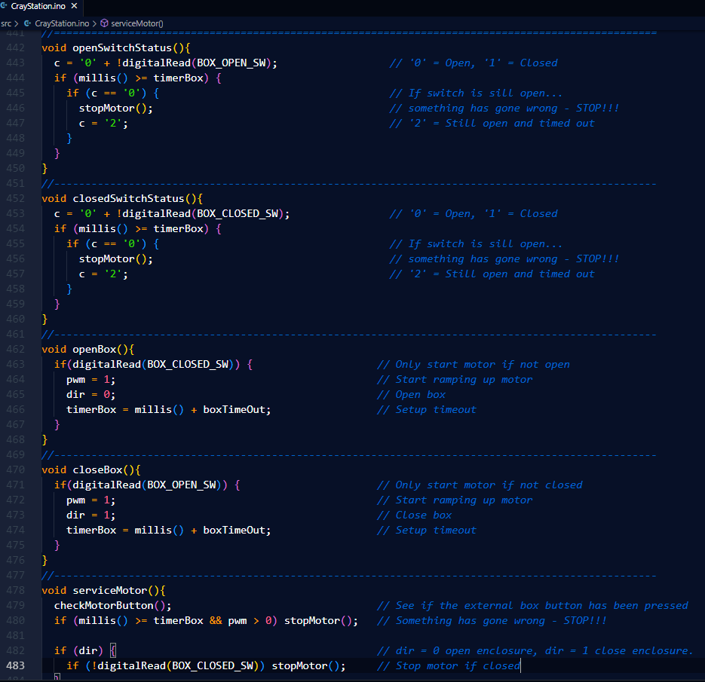
Components – Arduino Nano
832 lines of code, so far.

Slide 10
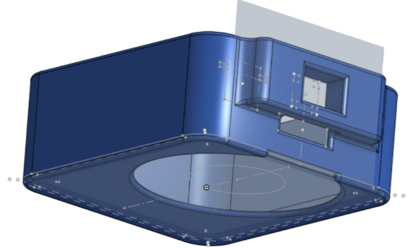
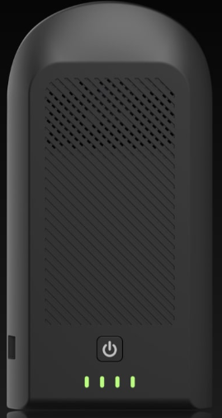
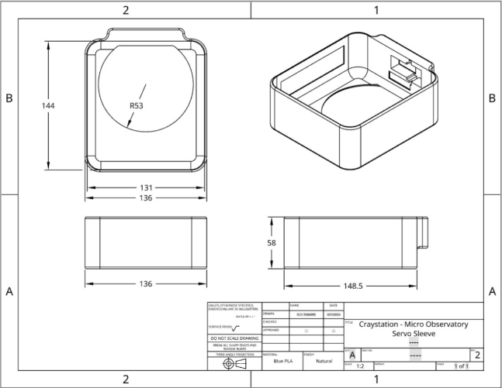
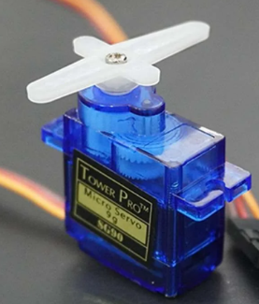
Components – Servo
As servo will be used to push the Seestar’s power button for two seconds to turn it on (or off). A servo can turn its arm accurately to a chosen angle.
There is plenty for torque of the one we’re using to push the button.
3D printed sleeve

Slide 11
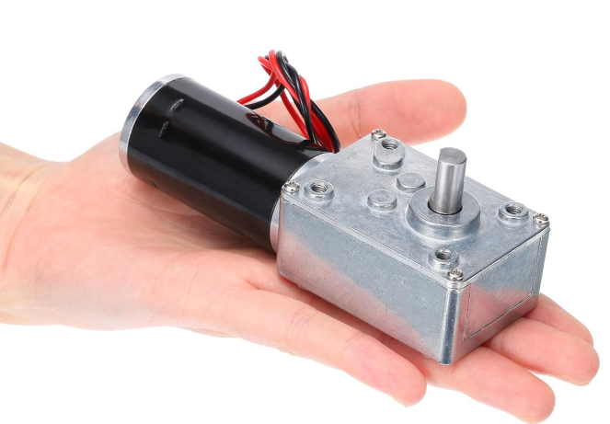
Components – Motor
The motor will be installed inside the enclosure and turn a timing belt and pulleys to open and close the lid.
Specifications:
Voltage: 12V
Speed: 3 RPM
Torque: 100kg/cm (plenty!)
D-shaft: 7mm diameter
More later…

Slide 12
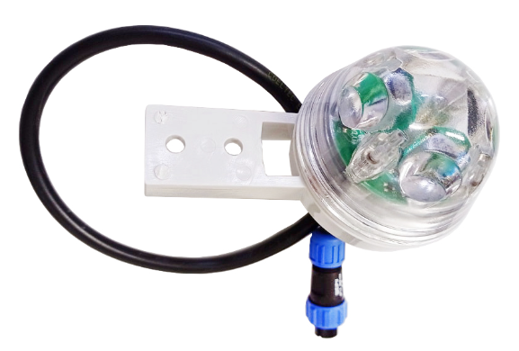
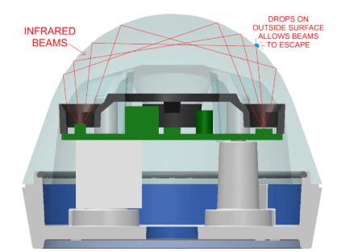
Components – Rain Detector
Hydreon RG-9 Rain Sensor will be used. I’ve used one for three years and it works very reliably.
It works on the same principle that car windscreen rain detectors work.

Slide 13
Components – Environment sensor
The GY-BME280 I2C sensor will be used and it can measure the following:
Temperature: ±1°C (-50°C to 85°C)
Humidity: ±3% relative
Air pressure: ±0.12mb
The information provided by the sensor will allow the user to:
Assess how much power to provide the to the Seestar’s or all-sky cam dew heater
How the temperature and air pressure may affect observations
Log these readings to record weather trends

Slide 14
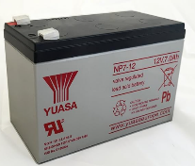
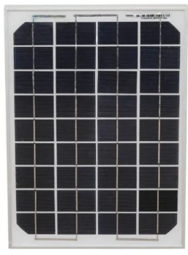
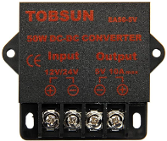
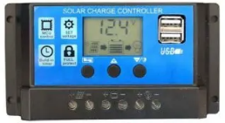

Components – Observatory Power
A 10w solar panel provides power to a solar charge controller, which in turn charges a 12V 7Ah lead acid battery.
A 12V to 5V converter provides power to electrical components in the observatory. An ammeter and voltage bridge circuits will measure the current consumed and voltage output of the solar panel and battery. This will provide an understanding of the battery’s charge status and power available. The Arduino can control which parts of the system to receive power and decide which parts should be powered down to preserve power.
12V 7Ah Lead acid battery
12V to 5V converter
Solar panel
Solar charge controller
Ammeter

Slide 15
Components – Webcam & LEDs
A wide-angle webcam will be installed inside the enclosure so that any issues can be seen remotely.
Additionally, the camera can provide visual confirmation to the user of actions carried out by the user. Also, sound can be played back. LEDs inside the enclosure can be lit to provide light for better seeing.

Slide 16

Components – Switches
Two microswitches will let the Arduino determine the status of the enclosure lid, whether it is fully open, fully closed or somewhere in between. The Arduino will know when to cut the power to the motor when the lid has reached the end of its full travel.
A switch on the outside of the box will allow the host to open the lid and get access inside.
Pressing it will open it, again will stop it, and one more time will close it.

Slide 17
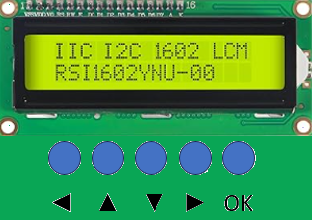
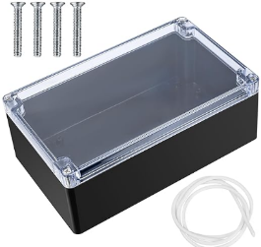
Components – Hand Controller
The hand controller box is connected to an outside weather-proofed socket via a coiled cable.
It is essential for the initial setting up (more later), and it allows the host to get useful information about the health of the observatory.

Slide 18
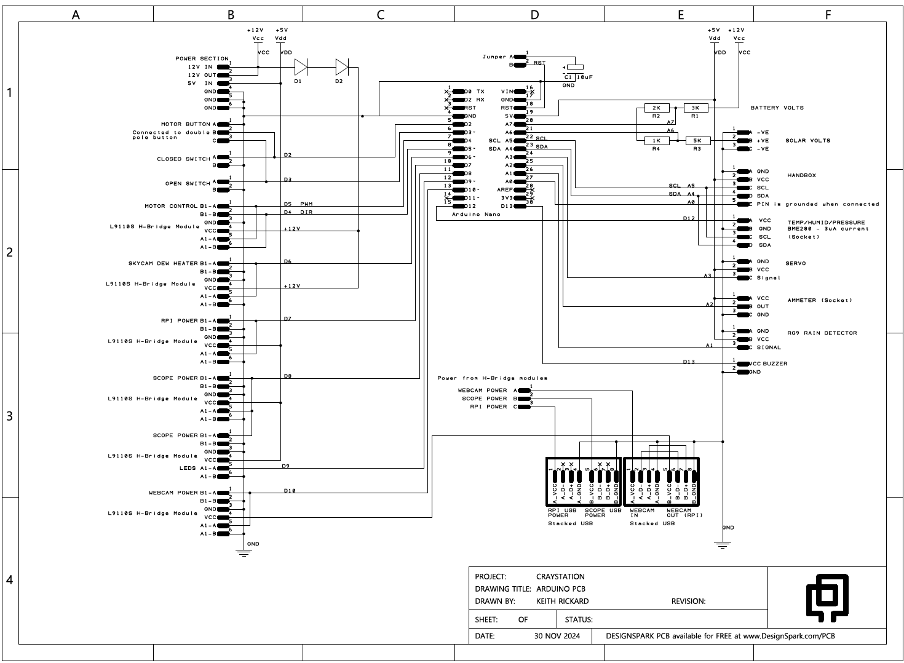
Arduino printed circuit board - schematic
A printed circuit board has been designed so that all the components to be controlled by the Arduino are easily connected.
It will ensure reliable operation and allow faulty components to be easily swapped out.

Slide 19
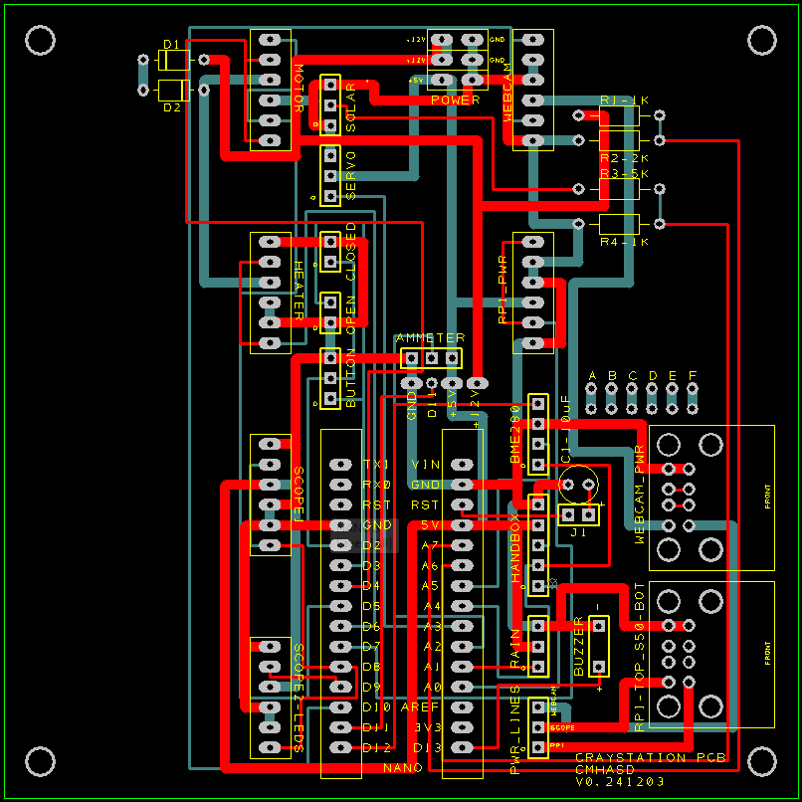
Arduino printed circuit board (PCB)

Slide 20
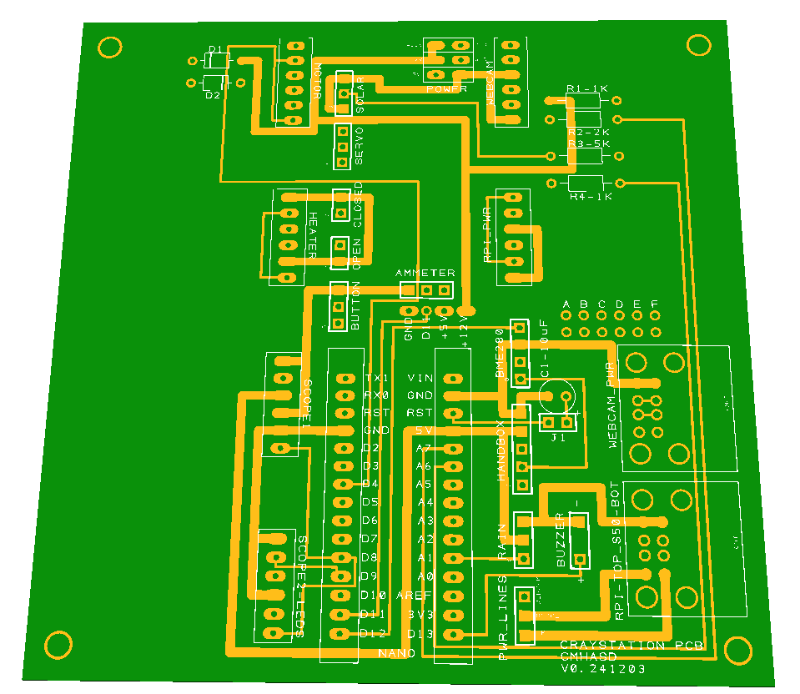
Arduino PCB – component side

Slide 21
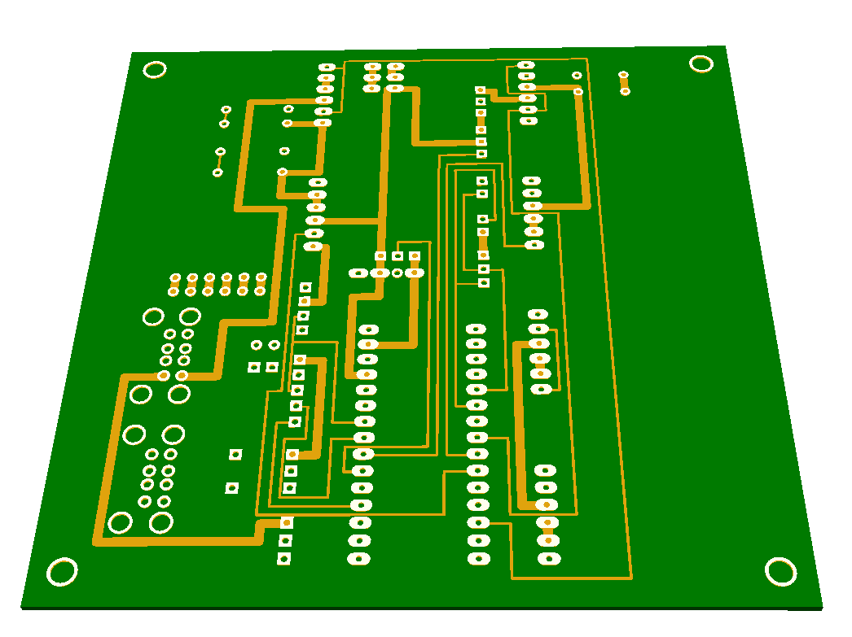
Arduino printed circuit board - underside

Slide 22
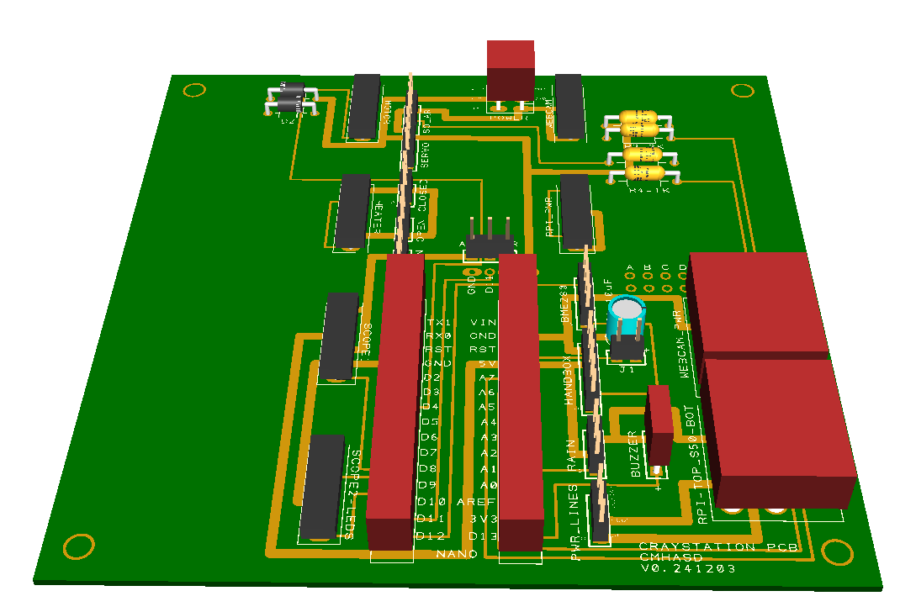
Arduino PCB – with components

Slide 23
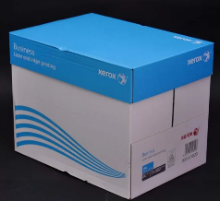
Enclosure
The enclosure is the most important aspect of the project. It has to:
be securely fixed
be easy to assemble
be weatherproof and provide protection to its contents
open and close reliably, even if the Seestar is not parked
provide host easy access to its contents
Its size will be about the same a box of five reams of A4 paper.
However, it will be determined by the size of the of the solar panel on the lid.

Slide 24
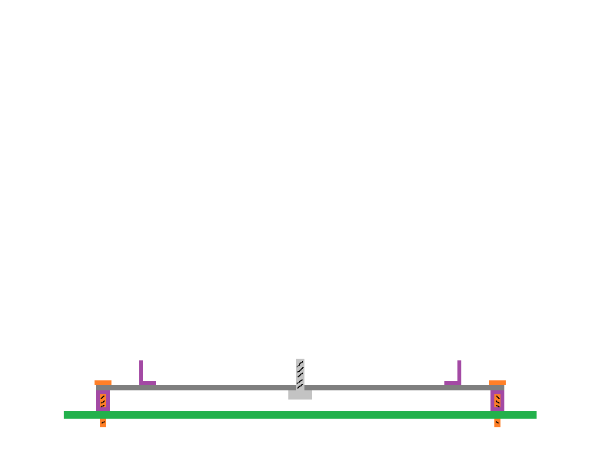
NOT TO SCALE!
Enclosure
Fixing
edge
Fixing
edge
Tripod
screw
Fixing
bolt
Aluminium
sheet base
Fixing
bolt
Surface

Slide 25
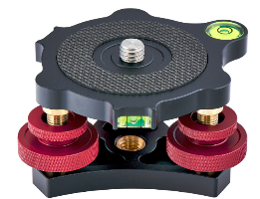
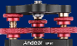
Enclosure
Leveller

Slide 26
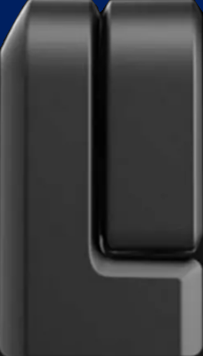
Enclosure

Slide 27



Enclosure
The design of the enclosure is such that the Seestar can see over walls of the box and can get a near 300° view of the horizon. The box will be of wooden construction and covered with a fibre glass coating.
Lid
Front view
Box
Fixed to
edging

Slide 28


NOT TO SCALE!
Enclosure
A timing belt and pulleys are connected to the motor spindle to operate the mechanism
Motor

Slide 29
NOT TO SCALE!
Enclosure
Motor

Slide 30

NOT TO SCALE!
Enclosure
Motor

Slide 31

NOT TO SCALE!
Enclosure
Motor

Slide 32

Remote connection
The Raspberry Pi in the CrayStation, once connected to the Internet, can be accessed remotely using a browser at the website: connect.raspberrypi.com
After logging on this screen is presented. From here the CrayStation’s Raspberry Pi desktop is presented on the screen.

Slide 33

Remote connection
This can be put into full screen mode if so wished.
The CrayStation Dashboard can be opened.

Slide 34

Remote connection

Slide 35

CrayStation Dashboard

Slide 36

CrayStation Dashboard

Slide 37

CrayStation Dashboard

Slide 38

CrayStation Dashboard

Slide 39
Seestar ALP
Seestar ALP is an open-source automation platform designed for the Seestar S50. It allows full control of the Seestar.
It is in continual development and improving all the time. Its GitHub page is here: https://github.com/smart-underworld/seestar_alp
A good demo of watching Seestar ALP in action can be found on YouTube here:
https://www.youtube.com/watch?v=tQRIVPq0CYU

Slide 40

Seestar ALP

Slide 41

Seestar ALP

Slide 42

Seestar ALP

Slide 43

Seestar ALP

Slide 44

Seestar ALP

Slide 45

Seestar ALP

Slide 46

Seestar ALP

Slide 47

Seestar ALP

Slide 48
Setup – identifying host
Ideal locations? Here are some suggestions:
Northern Hemisphere: Arizona, Hawaii, Japan, Tenerife Equatorial: Barbados, Hawaii Southern Hemisphere: Australia, New Zealand, South Africa Preferably somewhere with many clear nights!
Approach member acquaintances, astronomy clubs, universities , observatories, Exo-clock members, etc
Ensure willingness and competency of host
Host to determine suitable local location with good dark skies and horizon
Good access to the Internet via WiFi

Slide 49

Setup – identifying host
X
X
X
X
X
X
X
X
X
X

Slide 50
Setup – shipping the observatory
To keep shipping costs to a minimum:
Send only the enclosure, i.e. don’t send the Seestar S50 nor battery
Get a local suppliers to send a Seestar S50 and battery to the host (Useful as if there is a fault with Seestar then it can be sent back to supplier for replacement)
Also send hardware spares
May flat pack it for assembly by the host?

Slide 51
Setup – tasks for the host
Tasks need to be kept to the minimum, but the host will have to carry the following when setting up the observatory:
Decide where to mount the observatory safely and securely
Fix base down, screw on the tripod leveller and place the Seestar on top
Use the app to level the Seestar using the leveller
Using the Seestar app on a smart phone, put Seestar in station mode and connect it to the host’s WiFi network
Place enclosure over the Seestar, secure it down
Use hand controller to connect the RPi to the WiFi and Internet
Advise us when done along with the site’s global coordinates

Slide 52
To-do list
The following development work is still to be done:
Write the CrayStation app for the RPi
Bench test the hardware
Build the enclosure
Test, test, test, and when done, test again and then some more
Future development?
Schedule objects to be imaged and have image files emailed to user when done
Automatically check sky and weather, then if good carry out the schedule
Upload all-sky cam view and weather information onto a website

Slide 53
End
Follow the project at:
https://github.com/CMHASD/CrayStation_MicroObservatory
Questions?

